Slide 1
Software Requirement Specification

Slide 2
Software Requirements
Maps
1. Open Street Maps -
2. Tile Mill
3. Leafletjs
Front End of Application (look of the app)
1. HTML 5
2. Twitter Bootstrap
3. Java Script
4. CSS
Back End Data Processing (for proper search and correct data being displayed)
1. phpMyAdmin
2. MySql

Slide 3
Work Flow
Data from data.gov.in
Find and compile data
Collate all Data
Work on front look of the App
HTML 5, CSS,Java Script
Create Data Base.
Manage data and write MySql Queries.
To get desired information on giving
input location
My Water_ My Condition

Slide 4
How user will navigate through the Application.
Enter the Location in the given field.
There is also an option for detecting current location.
The user will then be directed to a page with district specific details on cause, impacts, remedies for the type of contamination.
There is also a visualization tab ,which will display a graph that explains pattern of contamination in that region.

Slide 5
Web
Application
This is a Single Page Website

Slide 6
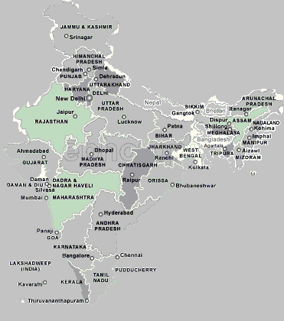
My Water My Condition
Water Facts
Purificat
ions Technique
Harvest
ing Methods
Search Engine
Enter State
Enter District
Feed
backs
Submit

Slide 7
Using The Map
Location field will have automatic line completion intelligence (using Database)just like Google search engine gives complete line based on what is typed.
Current Location: Location field will be filled automatically based on IP address of user; Geo-location
Submit Button: Search the database for contamination details of the location filled in location field and navigate the user to the it’s position.

Slide 8
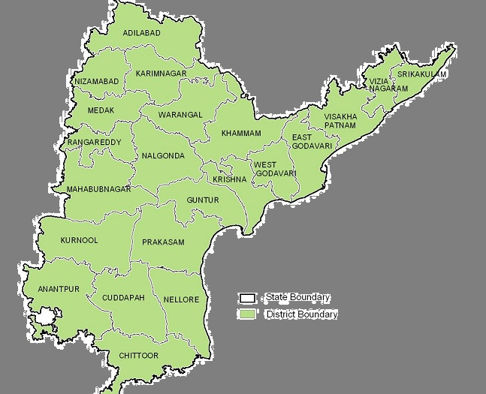
LOCATION --
Andhra Pradesh
CONTAMINATION --
Arsenic
Causes
Impacts
Remedies
Purification

Slide 9
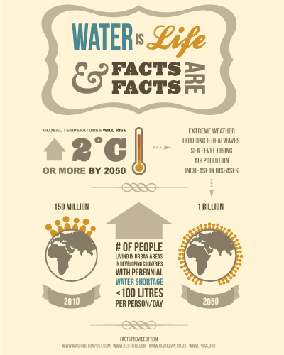

Water Facts
More than 3.4 million people die each year from water, sanitation, and hygiene-related causes. Nearly all deaths, 99 percent, occur in the developing world.
Lack of access to clean water and sanitation kills children at a rate equivalent of a jumbo jet crashing every four hours.
"[The water and sanitation] crisis claims more lives through disease than any war claims through guns."

Slide 10
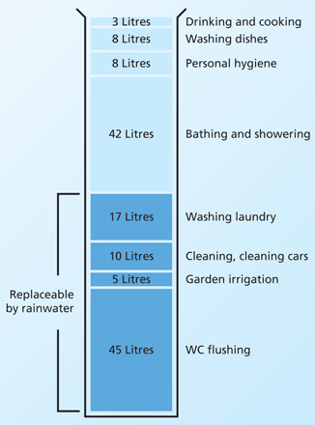
Harvesting Methods
You pay for water twice, as it enters your property and as it leaves it.
Water use has increased by 70% since 1970
Each person uses about 150 litres of water every day. About 60 litres of this is for toilet flushing
Toilet flushing is the single largest user of household water, 30-40%, up to 90% for offices.
Save Water
The installation of a rain water harvesting system ensures that:
Soft rainwater contains no calcium deposits, You will save on de-calcification products.
You save money and the environment benefits with you!

Slide 11
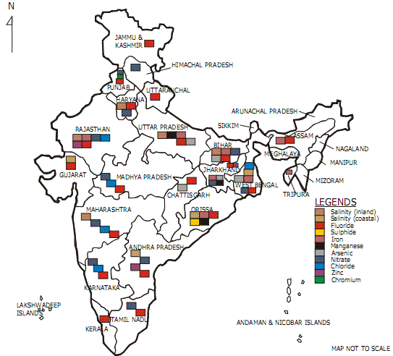
Map View
Contaminations
Alkalinity
Arsenic
Fluoride
Iron
Chlorine
TDS
Nitrate
Feed
Backs
f g+ tweets

Slide 12
Mentors
- Senthil Raja S
- Sandipan Rawat
Team
- Vineeta Mehta
- Siddharth Gautam

